Slide 1


Asteroids, the Game
scratch.mit.edu
Warmup:
Review: Controls
Introduce: Clones
Next step: evolution
Wrap up

Slide 2
Tonight:
Asteroids
We will take a project with some costumes
A space ship
A bullet
An asteroid
Warm up: Change the space ship to rotate and move
Then: A quick review on script blocks.
First improvement: Make more asteroids (using Cloning)
Then: make them move
Second improvement: Add bullets!
Optional improvement: Score on hit (Variables)
Final: Show your project!
Epilogue: Bonus:
http://scratch.mit.edu/projects/16743509

Slide 3

5 minute Warmup! Launch your asteroid game
Go to scratch.mit.edu and sign in if you have an account.
Start with scratch.mit.edu/projects/17772258
(Re-mix it to make your own copy)
Change the background
I chose ‘stars’ from the built-in backgrounds
Make the ship rotate (by 8 degrees) when you press right or left keys

Slide 4
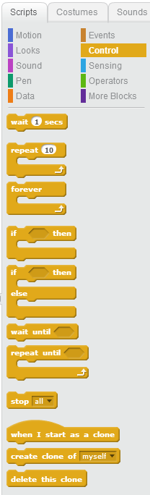
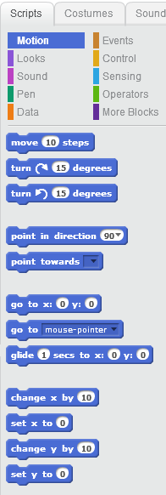
A quick refresher on code blocks
Motion
Control

Slide 5
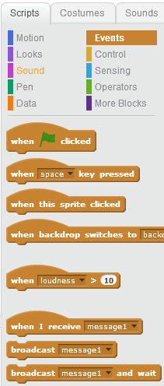
Events and Messages
What are some important game events?
Fire!
You Lose (or Asteroid Impact)

Slide 6
Clones Making more sprites
Clones
Clones
Clones
Some times, you will want several of a thing
You don’t want to have to paint more than one
You don’t want to have to attach script to each one
So, Scratch lets you easily ‘clone’ one of your sprites
We’ll start by cloning the asteroid

Slide 7
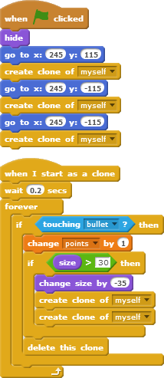
Asteroids – next steps
Asteroid Clones
The game starts with 3 huge asteroids.
If a bullet hits a small asteroid, you Score!!
If a bullet hits a bigger asteroid, it breaks up
If it goes off the screen, it shows up on the other side. Just use the backpack to copy that code from
http://scratch.mit.edu/projects/17450708

Slide 8
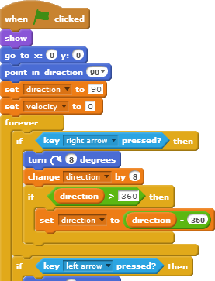
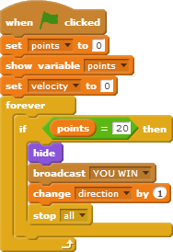
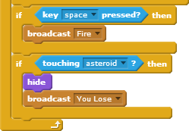
Let’s talk about the space ship
It sets up the game’s starting conditions
It handles all key presses (up, down, right, left, space)
It detects if an asteroid hits it.
(movement….)

Slide 9
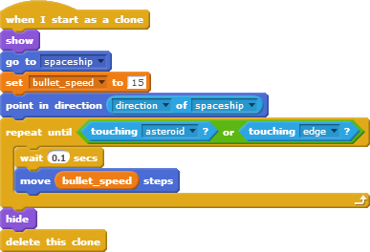
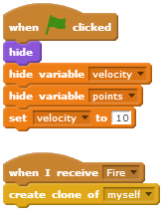
Let’s talk about bullets
It’s easier to start coding with just one bullet (not using clones),
but it’s easier to DIE, too.
Since the space ship does the firing, it can send a message to the master bullet, which receives the Fire message. (below left)
Bullet logic is less tricky with “Go to” and “point in”
Note: it deletes itself

Slide 10
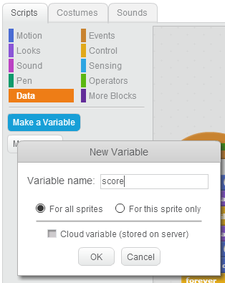
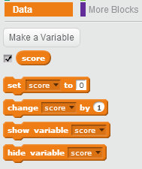
Data. Also called Variables
If you have information that changes, use “variables”
What data might you want?
Smallest change: Add the score (“points”)
Use the checkbox to have it automatically display
Later, maybe a “lives:” counter

Slide 11
Next improvement:
Let the ship move about.
Alternatives:
“Up key” to boost and stop when up is released
“Up key” to increase velocity, down key to slow down or stop
The “go to” and “point in” blocks from before are very, very helpful!
Improve the Art
Images.google.com is my friend.
“You Win”
I added it to the game, but the best games just increase the challenge
Increase the challenge
Rather than ending after clearing the asteroid field, start the next level with more and/or faster asteroids.
Like ‘real’ asteroids, have a ship come along that fires at you.

Slide 12
Next steps:
Most games give you multiple lives.
What topics did we cover which would help?
I’m thinking that we might have a variable called “lives”
We set it to ‘3’ on green flag, decrement when the asteroid hits the ship, and send ‘show game over’ when it drops to zero.
How could we ‘refactor’ the code so we can
Restart the game on a mouse click (& change user messages)
We must remove any ‘stop all’
I think I need a new event-message called “Start Game”
I think I could merge all the information sprites (“How to start”, “Game over”) into one sprite. I would make the 2nd costume in the sprite (“Game Over, play again?”)
I think I need a new “You were hit” message, rather than just “You Lose”
I would put message handlers on the messaging sprite to set the correct costume to match the messages.
I would move nearly all of the existing code in the ‘on Green Flag’ event into a new block (in More Blocks) ‘Start Game’ handler, and have the on green flag handler send a ‘Start Game’ message.

Slide 13
Bonus Material
Multiplayer Scratch depends on Cloud Variables
I’m still a ‘new scratcher’, but some kids in here have it!
This looked like a fun game
http://scratch.mit.edu/projects/12785898/
Did you like this class? What should I cover next? Maybe some physics? (Bounce, tension)
I’ve been putting projects that wow me here: http://scratch.mit.edu/studios/353880
I’ve been putting projects that are easy to learn from here: http://scratch.mit.edu/studios/246979/

